Slide 1
Where is everyone?
Wifi fingerprinting analysis
Notes:
This morning I will be feeding back to you my analysis of wifi fingerprinting. Specifically, the project relates to the three buildings here at a university in Valencia.

Slide 2
The aim: should we recommend wifi fingerprinting to our client?
Assess the ability of wifi fingerprinting to predict a person’s location.
Wifi fingerprinting takes the signals from multiple wifi hotspots within a building to determine location.
Notes:
The aim of this project is to determine if we should recommend wifi fingerprinting to our client.

Slide 3
Recommendation
Our model for determining a person’s location using wifi fingerprinting should be incorporated into our client’s smart phone app.
Notes:
This presentation will present the case for why we should recommend the model we have developed to our client

Slide 4
Limitations of wifi fingerprinting
Signal strength is effected by human factors such as how the phone is held and bodies blocking the signal.
Can’t tell what direction someone is going in.
The system only works on Android phones.
Notes:
While we are recommending wifi fingerprinting, have to also take into account its limitations.

Slide 5
Overview
3 buildings with 4 or 5 floors depending on the building.
21,049 sampled points: 19,938 for training and 1,111 for validation.
520 WAPs (wireless access point)
20 users making the readings in the training set
Building 0
Building 1
Building 2
Notes:
Let’s just take a moment to remind ourselves about the dataset and information and were given to work with.

Slide 6
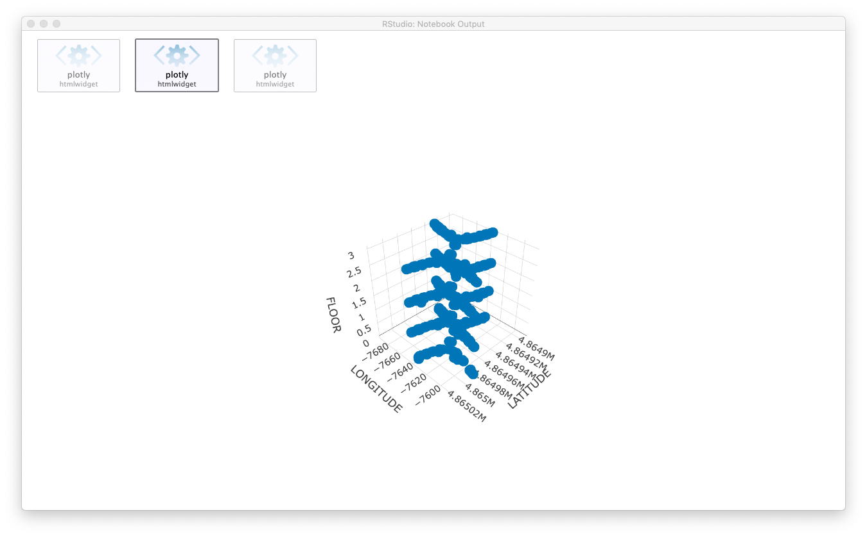
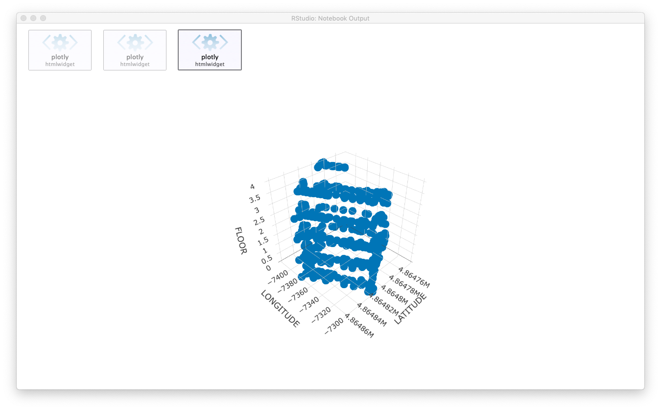
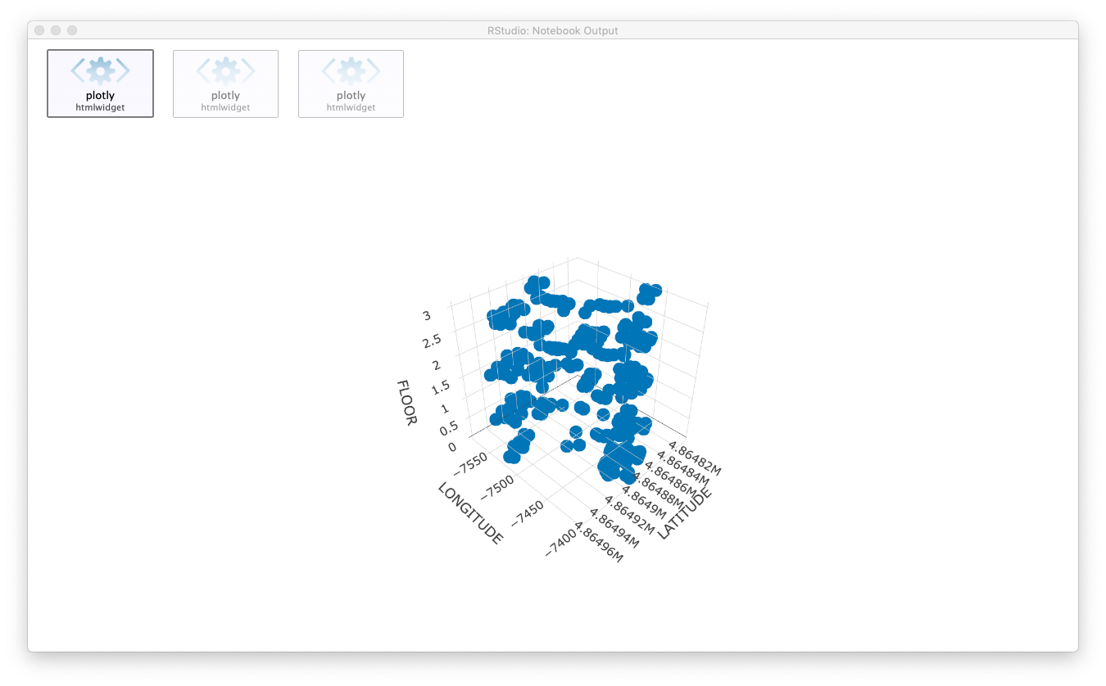
3-D plots of the buildings
Building 0
Building 1
Building 2
Notes:
These 3-D plots show the WAPs on each floor. Note the very few number of WAPs on the fourth floor of building 2. We will see later how this effects the predictions.

Slide 7

Dataset investigation: insights applied to training and validation sets
WAPs with a mean of 100
User6’s data
WAPs with a low variance
Relative position
Space ID (room)
Timestamp
Removed
Notes:
Our initial investigation of the dataset leads to removing
WAPs with a mean of 100, this means they were not receiving a signal
All data for user 6 whose readings regularly suggested they were literally inside the sensors – obviously not possible.
The variance for a WAP should be high and any WAP with a variance lower than 5 was removed.
Relative position, space ID and the timestamp were also removed.

Slide 8
Modelling using the waterfall approach
Predict the building
Predict the floor
Predict the longitude
Predict the latitude
Notes:
Location is made up of building, floor, longitude and latitude.
We have evaluated machine learning models to see which produces the most accurate predictions for these variables.
And the modelling follows the waterfall methodology.
We start by predicting the building and the results are added to the validation set ahead of making the predictions for the floor and so on. The easiest way to explain this is by demonstrating how it works.

Slide 9
Predicting the building
Model applied to the validation set to predict the building
Training set
RF and GBM prediction models
430 WAPs
Building 0
Building 1
Building 2
Notes:
So we begin by predicting the building using the WAPs in the training set. Produce RF and GBM prediction models. And then apply the models to the validation set to predict the buildings.
RF and GBM models are good choices because…
They are available as part of the H2O package whose speed is appreciated when working on a large dataset.

Slide 10
Accuracy of the models: predictions compared to the known buildings in the Validation Set
 | Accuracy | Kappa
RF | 0.9964 | 0.9943
GBM | 0.970297 | 0.953413
Notes:
We can see here the accuracy of the models and the table suggests the RF model has the best accuracy.

Slide 11
Predicting the building: confusion matrices
RF model
GBM model
Validation set
Validation set
0
1
2
0
2
1
0
535 | 0 | 0
0 | 304 | 0
1 | 3 | 268
0
509 | 0 | 0
27 | 306 | 5
0 | 1 | 263
1
1
Prediction
Prediction
2
2
These predictions replace the known buildings in the validation set
Notes:
This is verified when comparing confusion matrices for the two models. We are looking where the errors are and how many are across more than one building.
The predictions from the RF model replace the known buildings in the validation set.

Slide 12
Predicting the floor
Split the training set into three
Model applied to the validation set to predict the floor
Building 0
RF and GBM models for each building
Building 1
Floors in Building 0
Floors in Building 1
Floors in Building 2
Building 2
Notes:
Having predicted the building, we now move on to the floors.
First we divide the training and validation sets into three – one for each building.
Produce models to compare and make predictions in the same way as in the previous step.

Slide 13
Accuracy of the models: predictions compared to the known floors in the Validation Set
 | Building 0 | Building 1 | Building 2
RF Accuracy Kappa | 0.914 0.879 | 0.7467 0.6358 | 0.7868 0.7092
GBM Accuracy Kappa | 0.8673 0.8135 | 0.7072 0.5814 | 0.8309 0.7679
Notes:
Assessing these results, it would seem that the RF model is best for building 0 and building 1. And GBM for building 2.

Slide 14
Predicting the floors in Building 0: confusion matrices
RF model
GBM model
Validation set
Validation set
0
1
2
3
0
1
2
3
0
76 | 7 | 0 | 0
2 | 192 | 20 | 0
0 | 8 | 138 | 2
0 | 0 | 7 | 83
0
70 | 7 | 1 | 0
1 | 183 | 17 | 0
7 | 15 | 134 | 8
0 | 2 | 13 | 77
1
1
Prediction
Prediction
2
2
3
3
These predictions added to validation set for predicting the longitude

Slide 15
Floor predictions: correct and incorrect predictions
Building 0
Building 1
Building 2
Classification
correct
wrong
Notes:
The plot for Building 2 shows how not having many WAPs on the fourth floor has affected the results.

Slide 16
Predicting the longitude
Model applied to the validation set to predict the longitude
Split the training set into three
Building 0
RF and GBM models for each building
Building 1
Longitude Building 0
Longitude Building 1
Longitude Building 2
Building 2
Notes:
What you can see here is the training set has been expanded to include the floors and the models created for each building. Then applied to the validation set to predict the longitude.

Slide 17
Error rates of the models
 | Building 0 | Building 1 | Building 2
RF RMSE R² MAE | 11.1438 0.8296 8.3528 | 17.6427 0.8654 13.887 | 23.9917 0.5544 16.1968
GBM RMSE R² MAE | 14.8373 0.85417 11.2754 | 25.0329 0.8612 21.4694 | 25.871 0.6024 19.2860
Notes:
The previous steps were classification models. Predicting longitude and latitude are regression models and we have here the error rates for the regression models. With RF producing the best results. The MAE is measured in metres and we can see that building 0 is the most accurate.

Slide 18
Predicting the latitude
Model applied to the validation set to predict the latitude
Split the training set into three
Building 0
RF and GBM models for each building
Building 1
Latitude Building 0
Latitude Building 1
Latitude Building 2
Building 2
Notes:
The final step is predicting latitude. And you can see that the training sets for each building now include longitude. The process is the same.

Slide 19
Error rates of the models
 | Building 0 | Building 1 | Building 2
RF RMSE R² MAE | 26.8264 0.7166 23.2988 | 30.4019 0.7278 24.7370 | 23.9917 0.5544 16.1968
GBM RMSE R² MAE | 15.5253 0.7779 10.5900 | 20.1156 0.8168 16.6948 | 22.0241 0.5169 14.2581
Notes:
Looking at the table here, the GBM gives the best MAE results.

Slide 20
Longitude & latitude predictions: errors
Building 0
Building 1
Building 2
Longitude
Latitude
Notes:
Let’s take a moment to look at plots of the errors when predicting longitude and latitude, we can see that they essentially have a normal distribution. However, building two in particular has extreme outliers.

Slide 21
Latitude predictions: errors plotted against longitude and latitude
Building 0
Building 1
Notes:
These are plots of errors against longitude and latitude. Building 0 and Building 1 look essentially ok.

Slide 22
Building 2: the model assigned the outliers to Building 2 but they should have been in Building 0 and 1
Building 2
Notes:
However, we can see in this plot of building 2, the extreme outliers. It is clear that these predictions were assigned to building 2 when they should have been assigned to building 1 and building 0. The errors were then carried through by the waterfall method.

Slide 23
Conclusions
Errors are compounded as the methodology progresses.
Errors are high where there are not enough WAPs (top floor of building 2).
A combination of RF and GBM models creates the most accurate predictions for a person’s indoor position.
Wifi fingerprinting is appropriate for any indoor locationing and could be implemented in other large buildings such as museums and hospitals.

Slide 24
Next steps
Repeat with different models and parameters to see if get better results – used H2O RF and GBM for speed.
Investigate if more WAPs increases accuracy.
Accuracy is good but it could be improved with more readings in the areas that were sparse (eg. top floor of building two).

Slide 25
Thank you
Stacey Jackson

Slide 26
Appendices

Slide 27
WAP readings for User 6 and Phone 19

Slide 28
Predicting the floors in Building 1: confusion matrixes
RF model
GBM model
Validation set
Validation set
0
1
2
3
0
1
2
3
0
21 | 13 | 0 | 0
5 | 89 | 1 | 0
4 | 40 | 83 | 11
0 | 1 | 2 | 34
0
15 | 9 | 0 | 0
2 | 84 | 0 | 0
13 | 49 | 78 | 7
0 | 1 | 8 | 38
1
1
Prediction
Prediction
2
2
3
3
These predictions added to validation set for predicting the longitude

Slide 29
Predicting the floors in Building 2: confusion matrices
RF model
GBM model
Validation set
Validation set
0
1
2
3
4
0
1
2
3
4
21 | 4 | 0 | 0 | 0
3 | 104 | 13 | 0 | 0
0 | 1 | 31 | 0 | 0
0 | 3 | 11 | 42 | 23
0 | 0 | 0 | 0 | 16
0
21 | 7 | 1 | 0 | 1
3 | 104 | 6 | 2 | 8
0 | 1 | 47 | 1 | 0
0 | 0 | 1 | 38 | 14
0 | 0 | 0 | 1 | 16
0
1
1
Prediction
Prediction
2
2
3
3
4
4
These predictions replace the known floors in the validation set
Notes:
This is the confusion matrices for building 2, and it confirms the GBM is the better for model for this building. And these predictions replace the known floors in the validation set before moving onto the next predictions. This process was repeated for building 0 and building 1.

